Slide 1
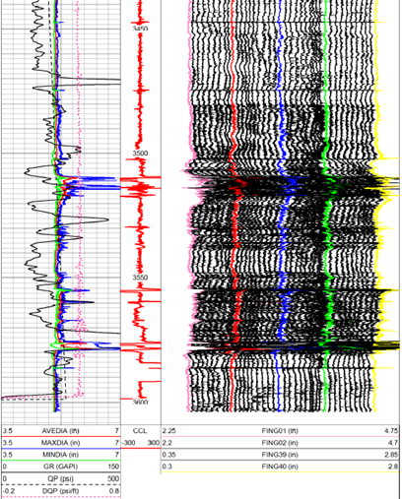
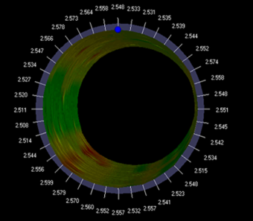
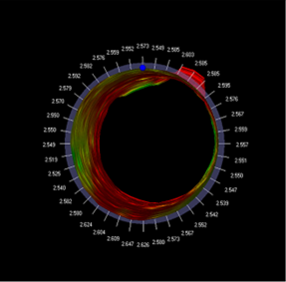
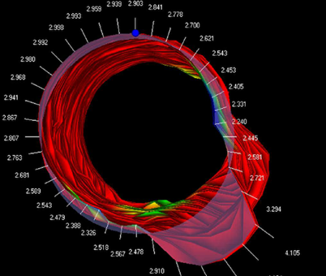
Background:
An operator is needing to set an Injection Packer in a very old well.
The state requires that the Packer be set at a depth no shallower than 3460’. Attempts were made to set the packer below 3510’, but the packer did not hold.
A 40 arm caliper was run to evaluate the casing.
Figure 1 shows the field print indicating good casing until about 3480’, marginal until about 3508’, and poor below this depth
Figure 2 shows the associated grading. Figure 3, 4 and 5 on next page are snapshots taken from the 3D video of the casing
Figure 2
. Figure 3 at 3461’ shows good casing.
Figure 4 at 3508’ shows the start of very bad casing which will not allow a packer to hold.
The packer was subsequently set and held at 3464’
Figure 5 at 3578’ shows very damaged casing with holes where a packer will never hold
Figure 1

